Slide 1
Overview of Team and Research Area
Task Manager: Chuck Downer (CHL)
4.1 Data Integration
Gutenson/Wahl (CHL)
Scott Christensen (ITL)
4.2 Vegetation Succession Models
Todd Steissberg (EL)
Todd Swannack (EL)
4.3 Spatially distributed soil moisture and run-off
Nawa Pradhan (CHL)
Ross Alter/Anna Wagner (CRREL)
Chase Hamilton (CHL)
John Eylander (CHL)
Rose Shillito/Steven Brown/ Clay LaHatte (CHL)
John Kucharski (EL)
Jennifer Olszewski (EL)
Chuck Downer (CHL)
Billy Johnson (LimnoTech)
Decades of experience in each sub-task
FORGE THE FUTURE
Notes:
Slide 13- Army recommendations here?
Response: Similar to Heilmeier question - If successful in solving the problem, what difference will it make and why? Who cares? The operational gap the Project is addressing, quantify the metric planned to achieve.
Include freeform slides to show task leads and team structure, discuss the technology, who’s doing what outside of ERDC (assessment of research across the S&T community – other services, DARPA etc)? How much resources are they investing and how do you plan on leveraging?

Slide 2
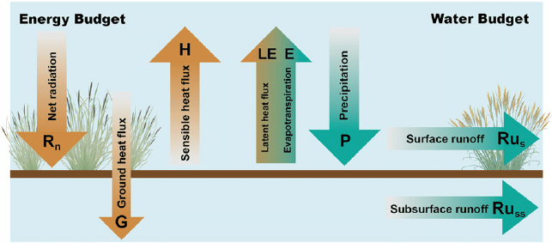
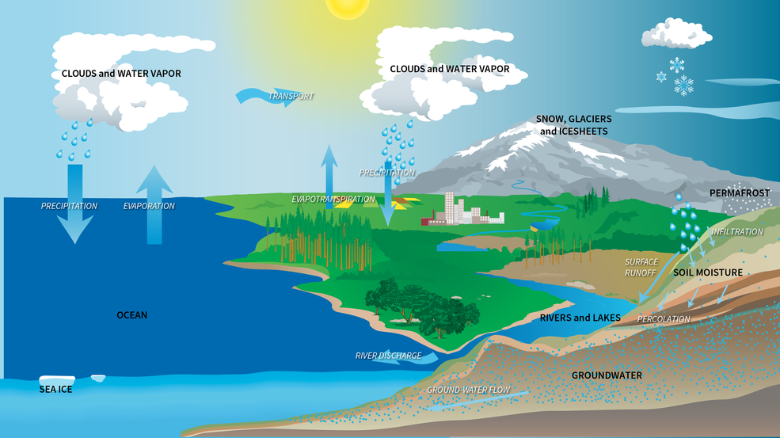
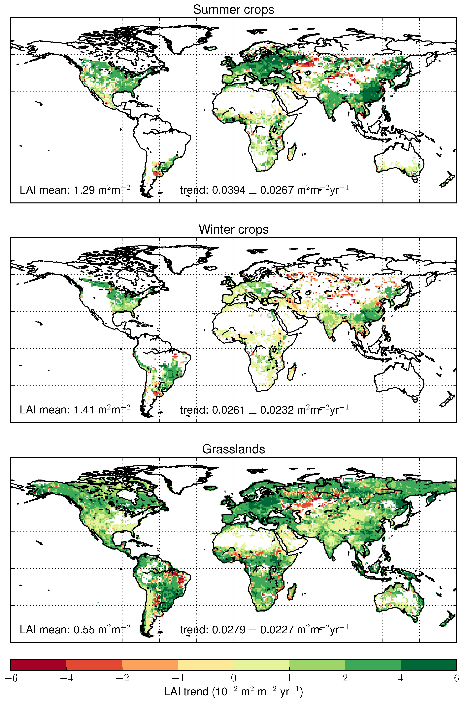
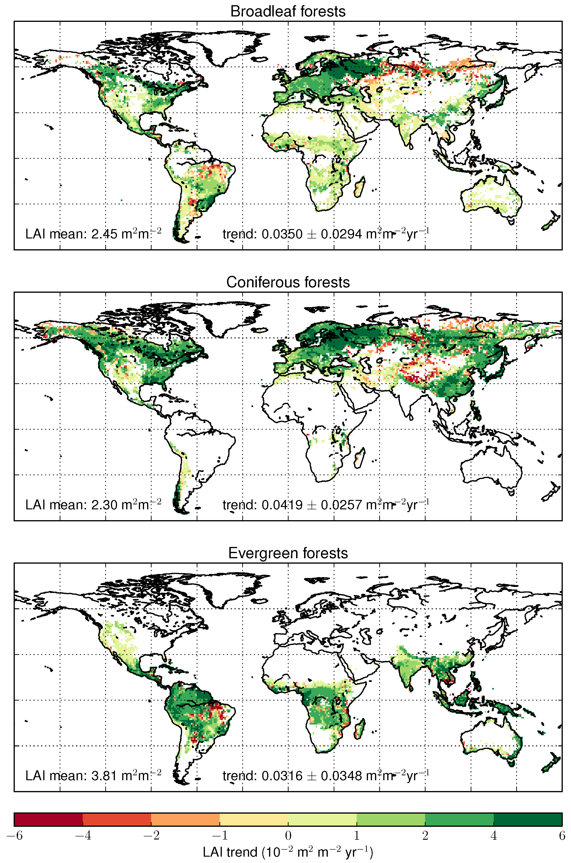
4.2 Vegetation succession models for improved ET estimates,
Sub-tasks 1 & 2
Example: Water and energy budget
Review models and model parameters used to estimate water balance components to estimate/simulate infiltration and runoff
Design methodology to estimate evapotranspiration using remote sensing measurements and modeled vegetation parameters such as leaf area index, root depth, and root mass
Correlate ET term with remote sensing measurements and modeled vegetation parameters
Develop algorithms to estimate root depth from remotely sensed measurements and modeled vegetation parameters
Example: Satellite measurements of vegetation parameters (Leaf Area Index, LAI)

Slide 3
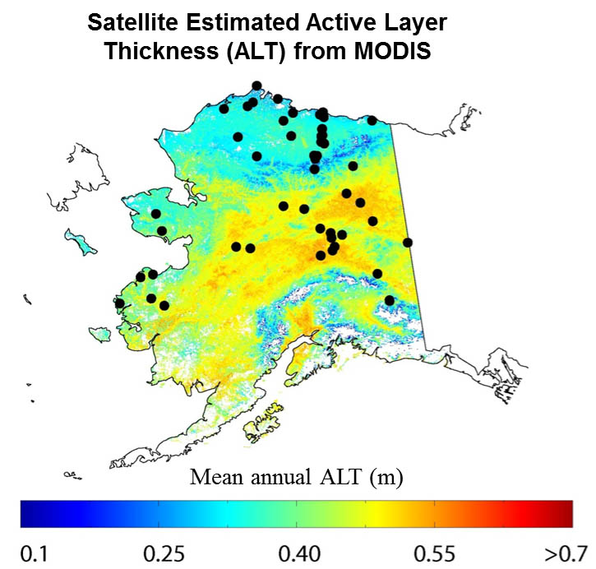

4.2 Vegetation succession models for improved ET estimates,
Sub-task 3
Example: Active Layer Thickness (ALT) succession & satellite estimates of ALT
Develop methodology to estimate evapotranspiration at high latitudes using vegetation indicators
Literature review on permafrost active layer hydrologic succession
Permafrost active layer vegetation root depth succession-ET lab experiments
Permafrost active layer vegetation root depth succession-ET field measurements
Undisturbed
Disturbed
50 ft
Active
layer
75 ft
50 ft
Permafrost

Slide 4
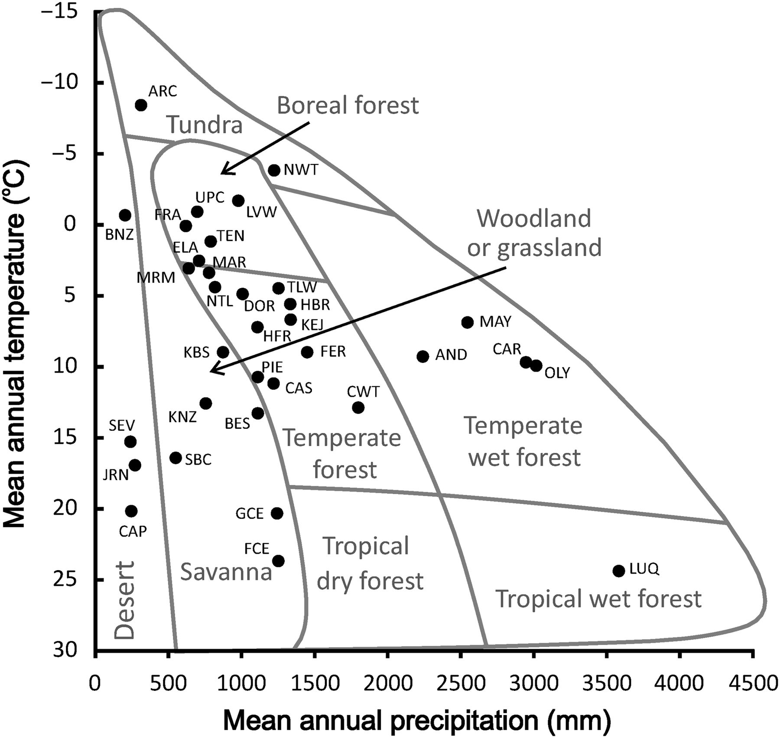
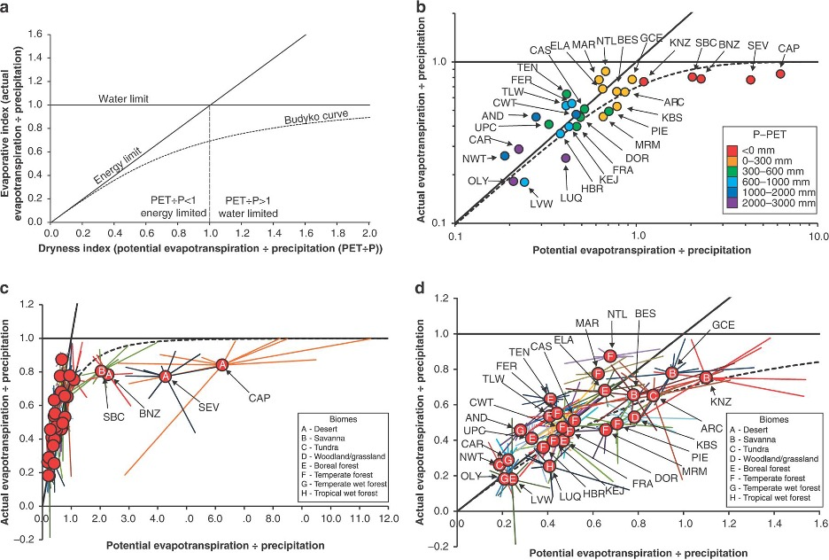
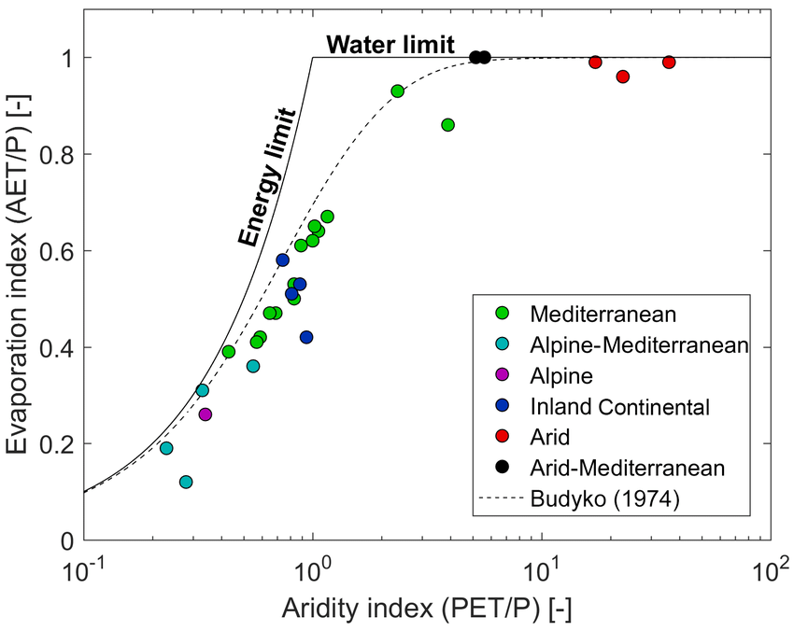
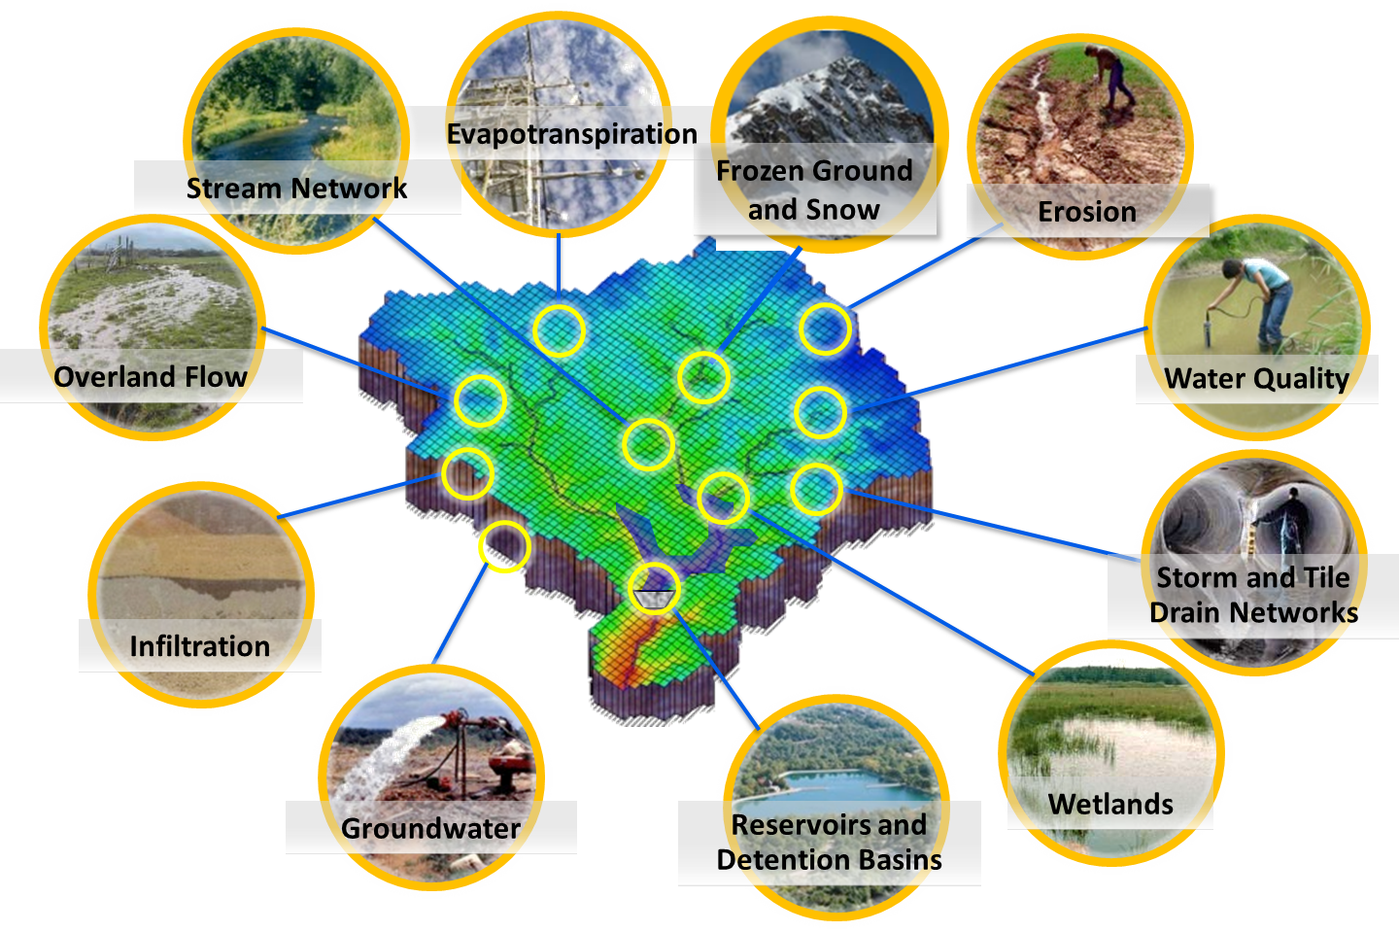
4.2 Vegetation succession models for improved ET estimates,
Sub-task 4
Example: Budyko curves. Ecosystem types can be broadly distinguished by energy and precipitation
Develop a process-informed stochastic hydrologic-vegetation model
Develop a machine learning (ML) methodology to derive the parameters for a stochastically based hydrologic model using a high-resolution hydrologic model (GSSHA) and remotely sensed data
Develop ML methodology to use Budyko (1974) relationships to derive vegetation parameters, and relate these to measurements to local climate conditions and trends
Develop and test the hydrologic-vegetation model using a case study
Example: Integrated hydrologic-vegetation system model

Slide 5
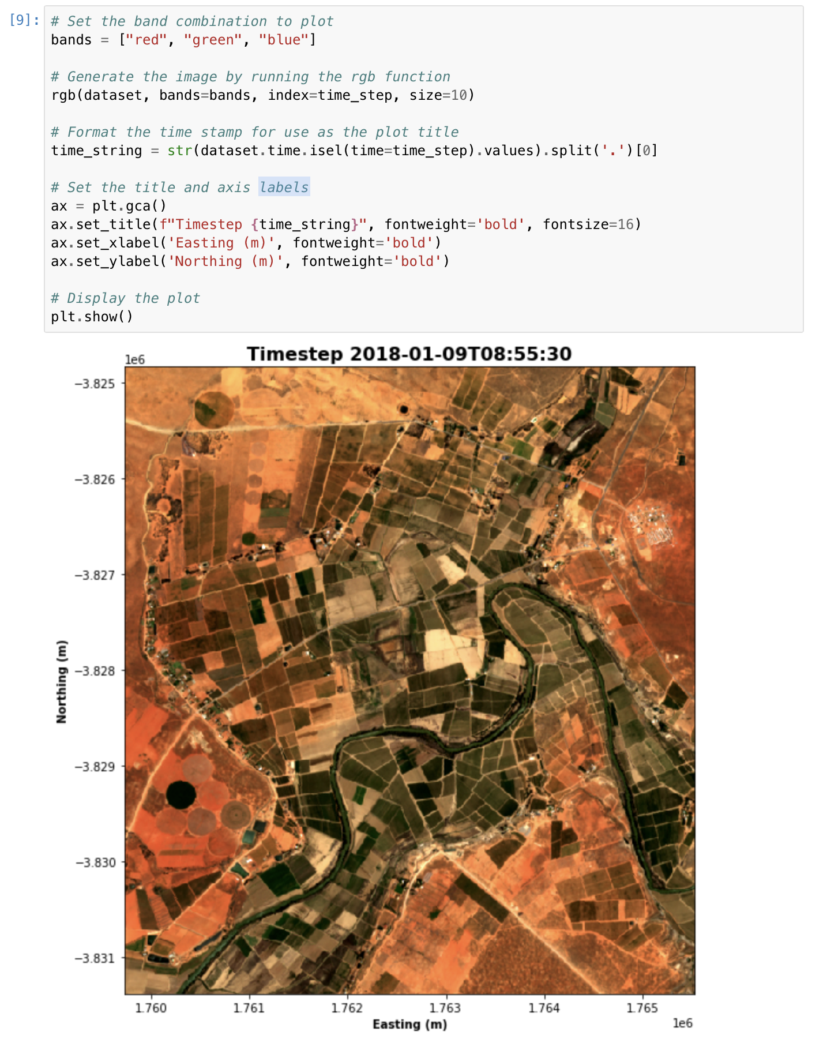
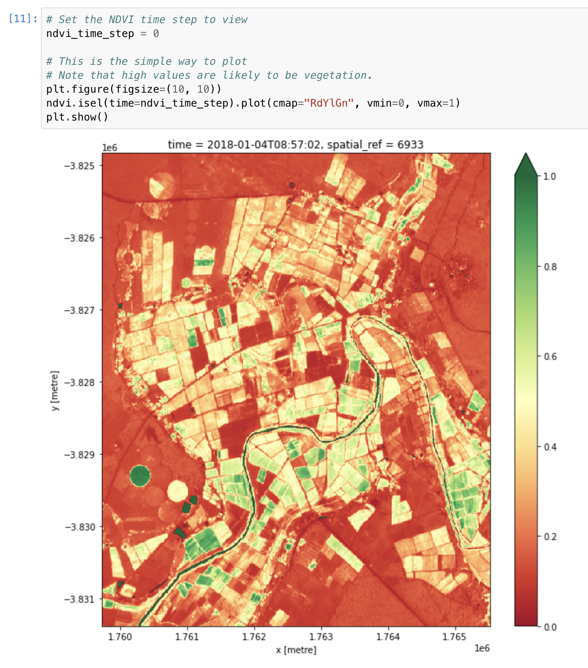
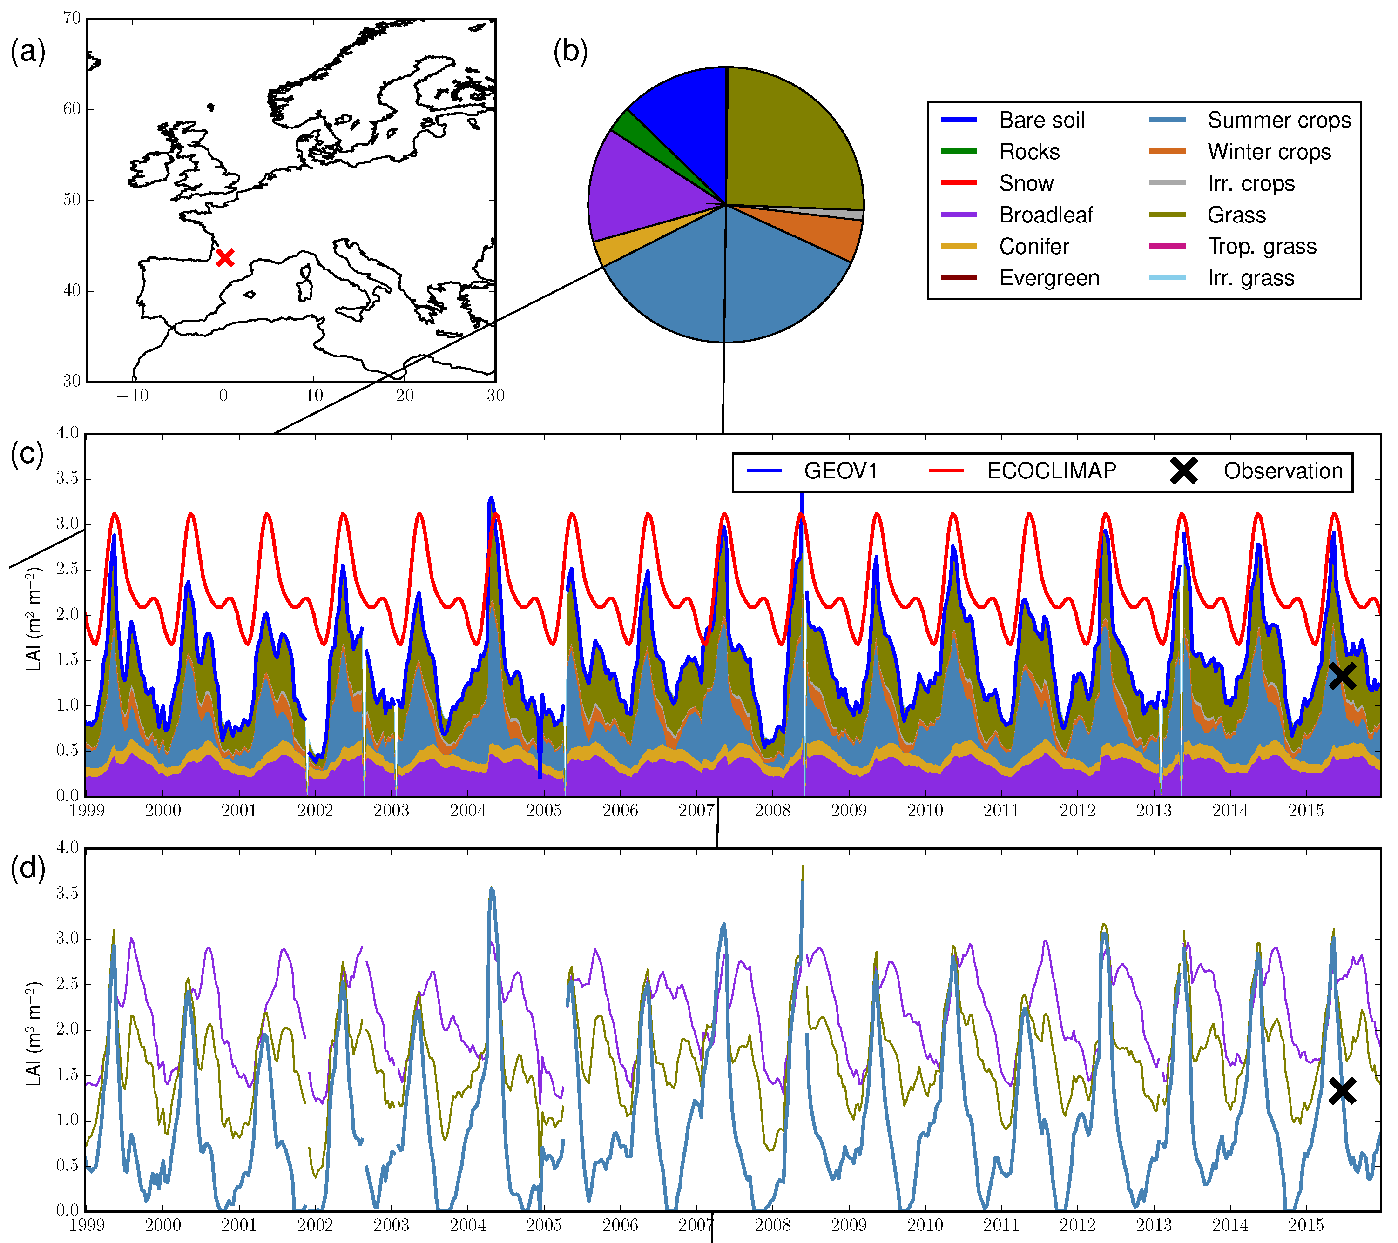
4.2 Vegetation succession models for improved ET estimates,
Sub-task 5 & 6
Example: Geospatial and time series data analysis
Data and model analysis
Journal papers/technical report

Slide 6
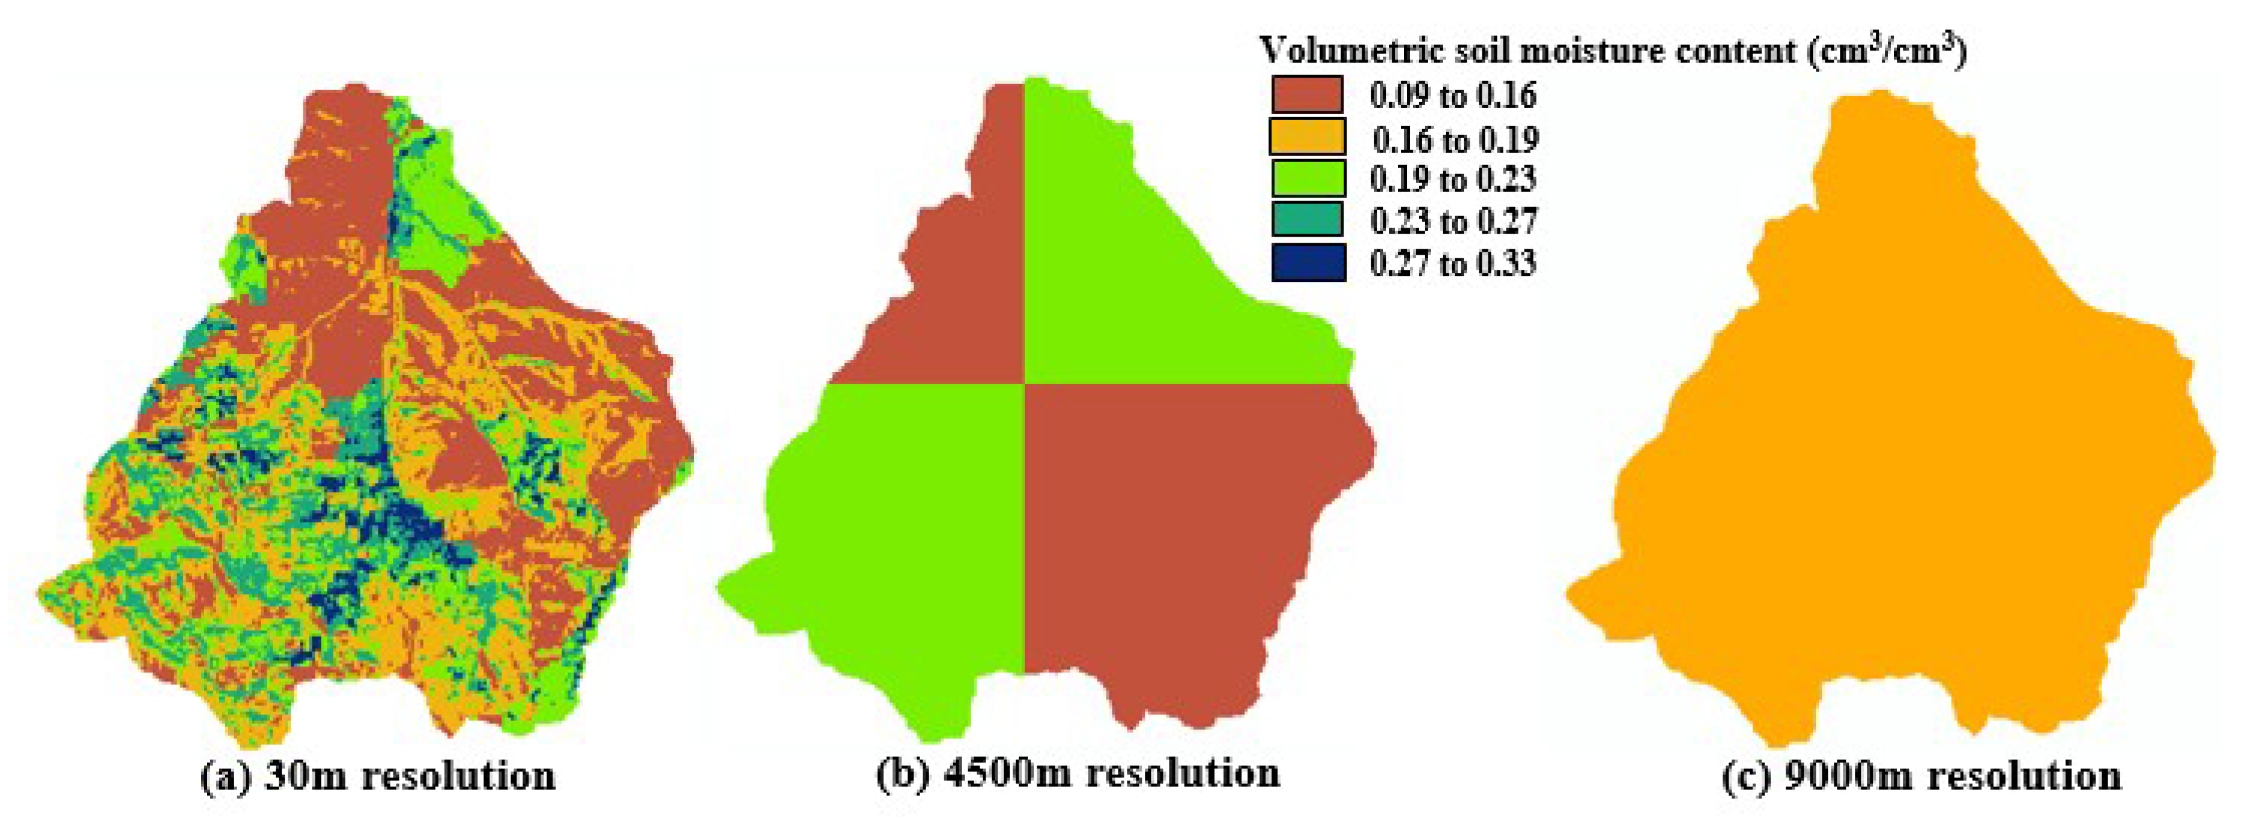
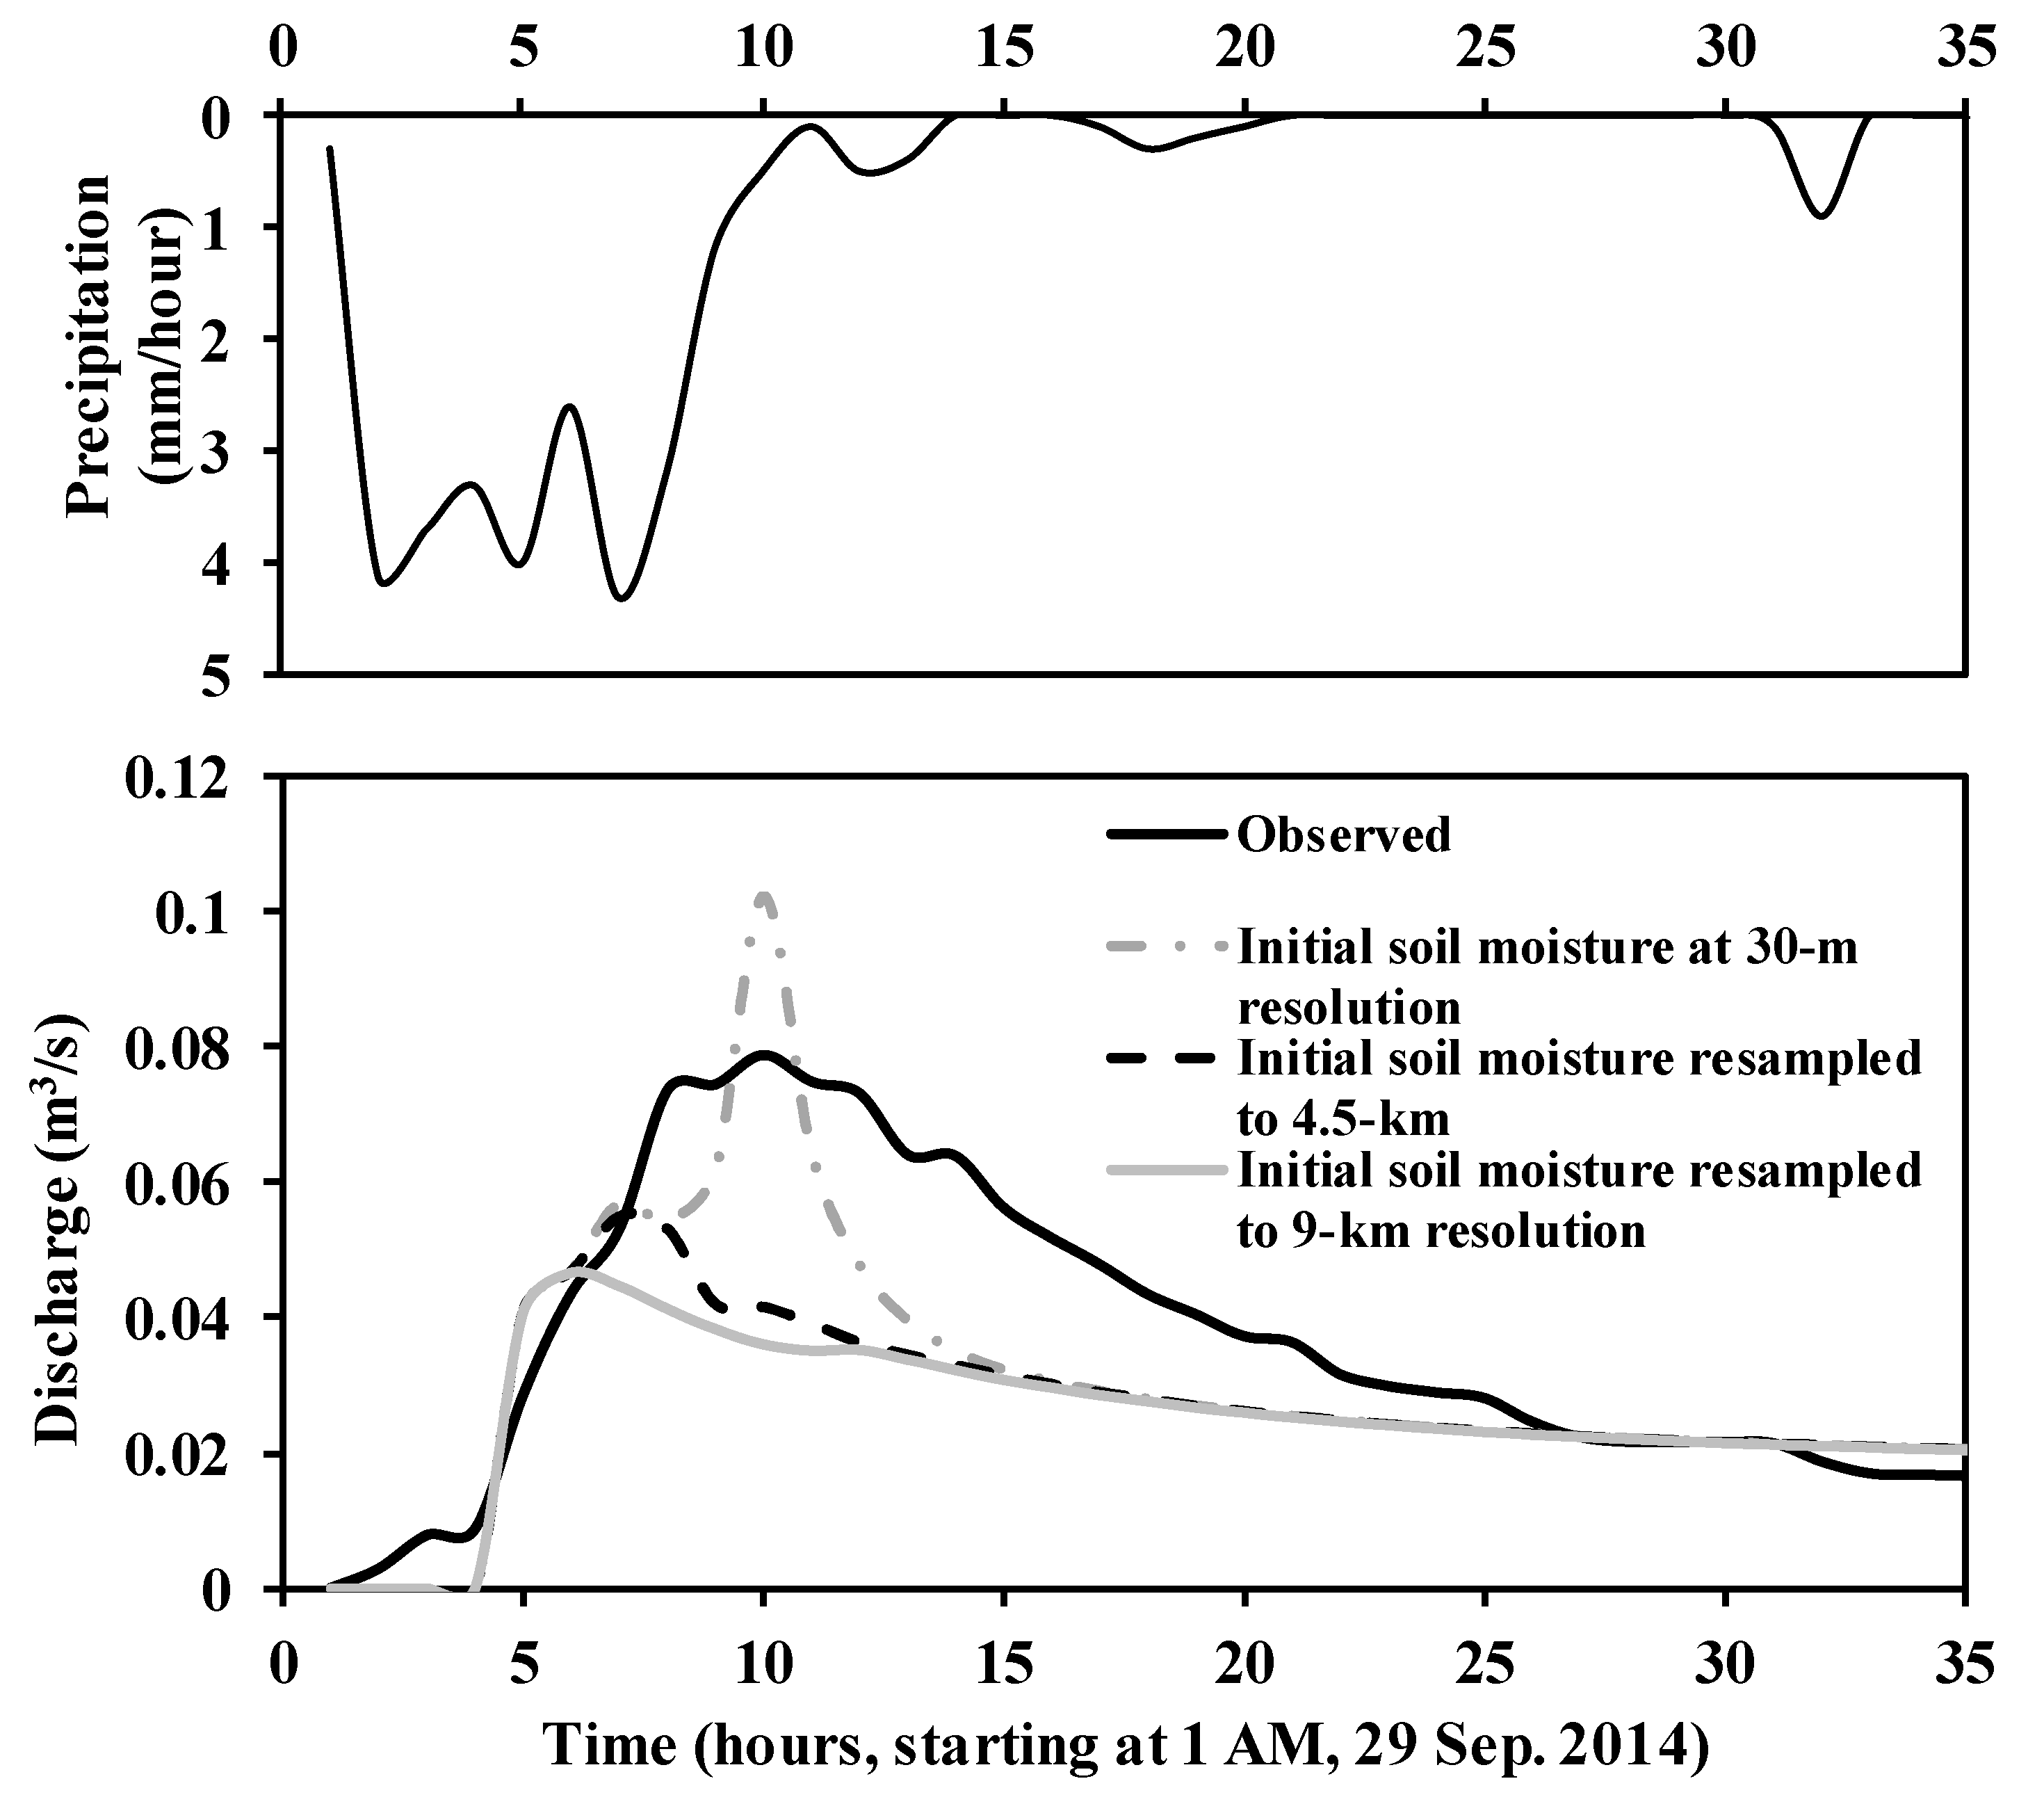
4.3 Spatially distributed soil moisture and run-off,
Sub-task 1
Example: Soil moisture initial condition effects
Initial condition exert a major role in hydrologic response.
Initial condition estimation and parameter value identification are not the same.
Development of initial condition estimation method/ estimation method options plays a significant role in predicting a hydrologic state or hydrologic state variables.
Along with parameter identification, this work unit will focus on developing methods to initialize key hydrological process: runoff generation processes, base-flow, thermodynamics.

Slide 7
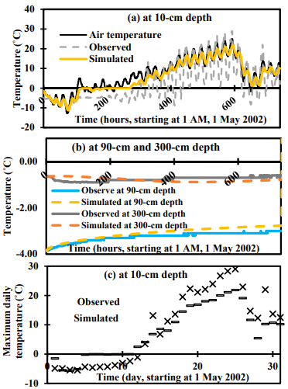
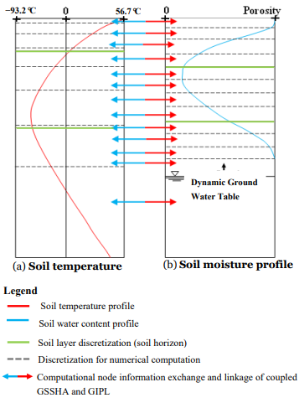
4.3 Spatially distributed soil moisture and run-off,
Sub-task 2
Hydro-dynamics / thermo-dynamics linkage
Active layer estimation
Re-visit the code
Visual interface
Faster method
Climate change effect
Active layer maps
Temperature and soil structure?

Slide 8
List of Collaborators/ Leveraged Projects across ERDC
Collaborating Project / Program | Direct or Reimbursable/Lead Lab | Communication Strategy
Wild-fire hydrology | Reimbursable/CHL | TBD/monthly
Thermodynamics is directly relevant to wildfire. Thermodynamics changes on soil structure can be leveraged by wildfire program and vice-versa.
Notes:
Slide 13- Army recommendations here?
Response: Similar to Heilmeier question - If successful in solving the problem, what difference will it make and why? Who cares? The operational gap the Project is addressing, quantify the metric planned to achieve.
Freeform vs guided chart – Kim will address during discussions.

